Slide 1
Partitioning
Data warehouses use the same types of partitioning as relational databases, but it’s especially relevant for fact tables, which can grow extremely large over time.
Range Partitioning:
This is the most common method in data warehousing. It partitions the data based on a range of values, typically a date field. For example, you might partition a sales fact table by month or year.

Slide 2
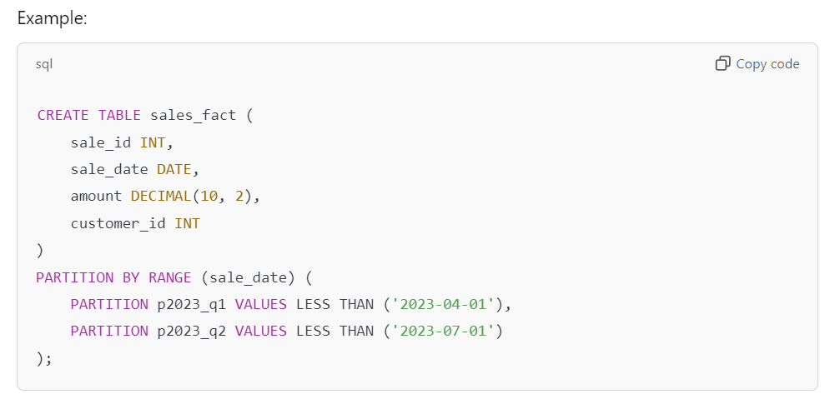
Example
In this case, data is partitioned by quarters (Q1, Q2), which helps improve performance when querying data from specific time ranges.

Slide 3
List Partitioning:
This partitions data based on a specific list of values, like geographic regions or product categories.

Slide 4
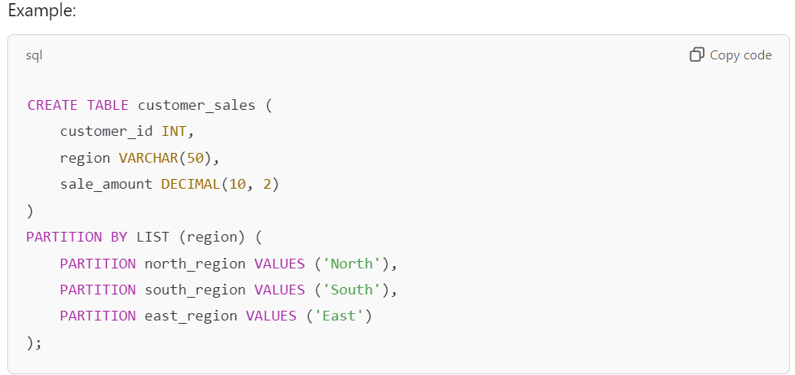
Example

Slide 5
Hash Partitioning:
This type of partitioning distributes rows across partitions based on a hash function, typically used for load balancing or cases where the distribution of data is uneven or unpredictable

Slide 6
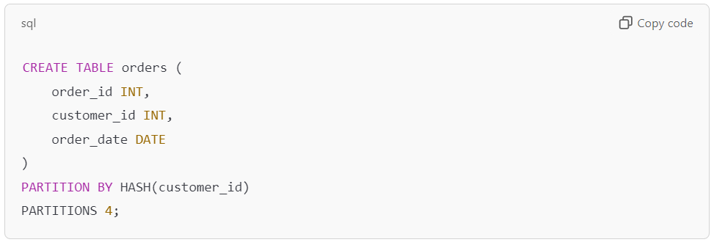
Example
creating a table partitioned by hash on the customer_id column with 4 partitions. This type of hash partitioning is useful when you want to evenly distribute data across partitions based on the customer_id value.

